Slide 1

Ctrl+Crop
Jay Rachelwar
Manan Patel
Surya Theja
Tarun Manoj

Slide 2
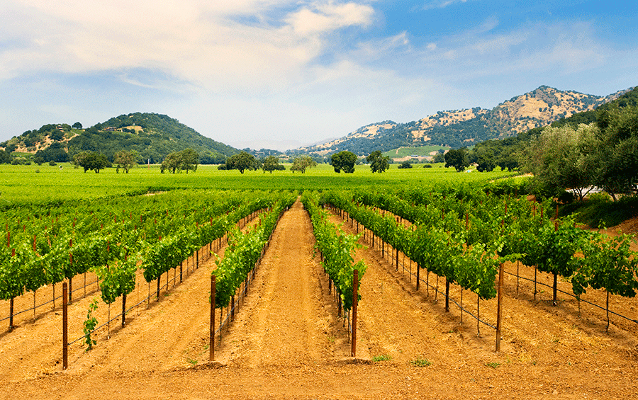
Problem
1. Generic forecasts don’t reflect farm-level microclimates.
2. Farmers unable to share their weather data.
3. Farmers willing to share do not get any incentives for their contribution.
Solution
1. Farmers having substations share their data.
Earn tokens for this, exchanged for money through a conversion rate
2. Farmers needing the data pay to use this data
Exchange money for tokens used to buy neighbouring data
3. Provides suggestions for suitable neighbouring farm data
4. Provides alerts for redundant substation installations.
5. Active contributors are rewarded with higher visibility, discounts, and community status
2

Slide 3
How it works
1. Farmers install weather stations → Data is uploaded automatically.
2. Data consumers (other farmers, co-ops, agribusinesses) access it:
Pay directly or use tokens (virtual currency) for easier access.
3. Farmers earn:
Micropayments (cash) when data is bought directly.
Tokens when sharing data, contributing insights, or engaging in discussions.
Trust of the neighbouring farms
3

Slide 4

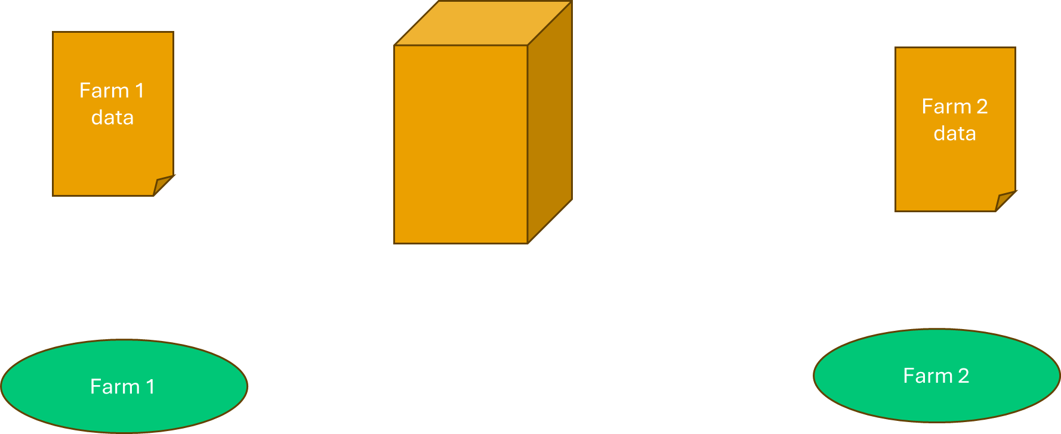
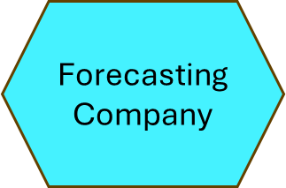

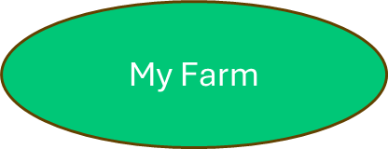
How it works
Data Collector
Karma System
API
4

Slide 5
Reputation System
Rewarding the Contribution of data
More consistent and good data
Badge the User
The Rain Observer
The Soil Expert
Karma System
Higher Tier = More Token/ per month
Leaderboard for higher visibility and motivation
5

Slide 6
Impacts
Hyperlocal weather data with intelligence and suggestions - better planting, irrigation, and pest control decisions.
Farmers generate new income streams (cash + credits).
Stronger community trust through transparent recognition (tiers).
Creates a self-sustaining farmer data economy.
6

Slide 7
Why us / Why this solution?
What’s the main challenge?
Farmers lack accurate, hyperlocal weather data and have no incentive to share their data.
What’s your solution in one clear sentence?
We turn farmer-installed weather stations into a shared data economy, rewarding farmers with micropayments, credits, and trust while delivering hyperlocal forecasts to the community.
7

Slide 8
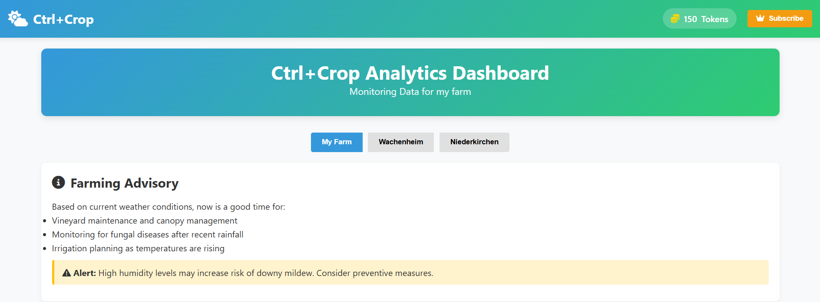
Demo / Screenshot
User / Subscriber Dashboard
8

Slide 9
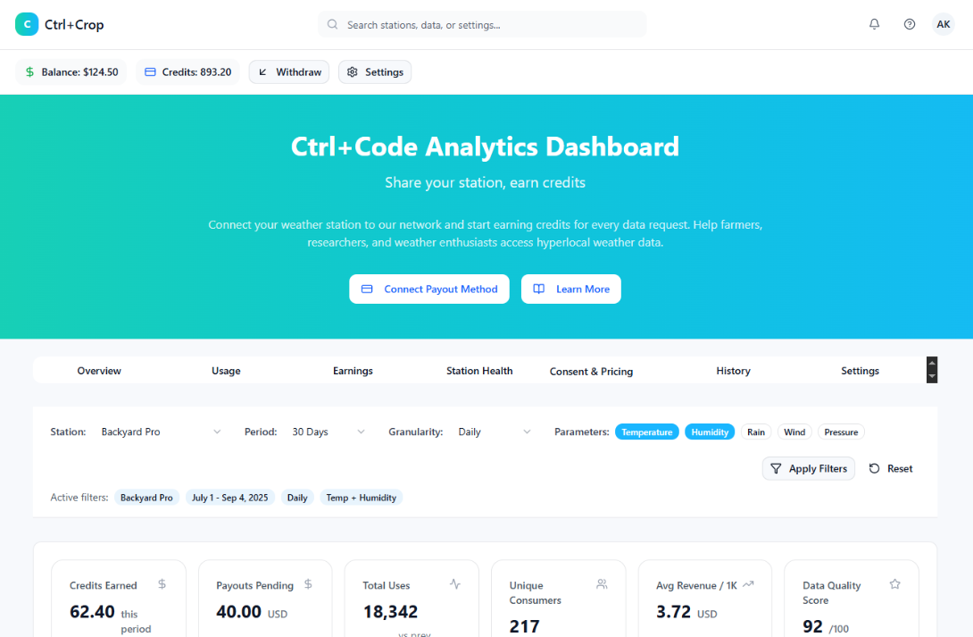
Demo / Screenshot
Contributor Dashboard
9

Slide 10
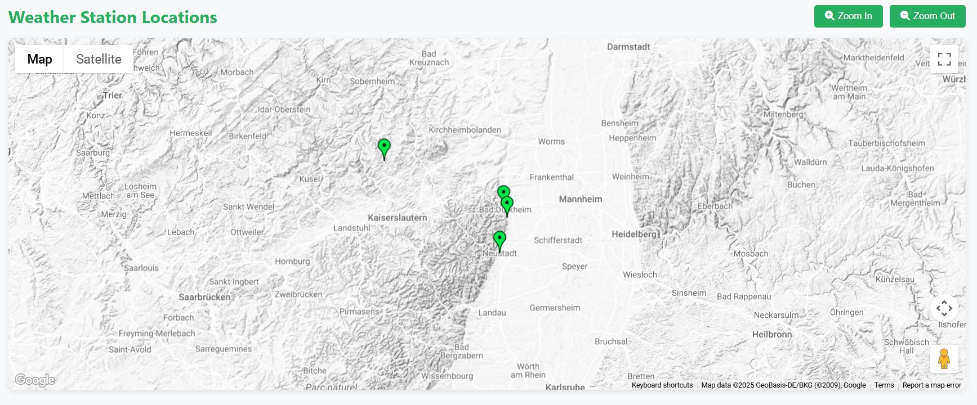

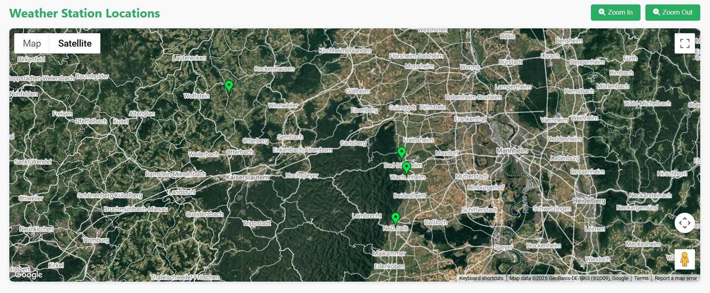
Demo / Screenshot
Satellite view
Map view
10

Slide 11
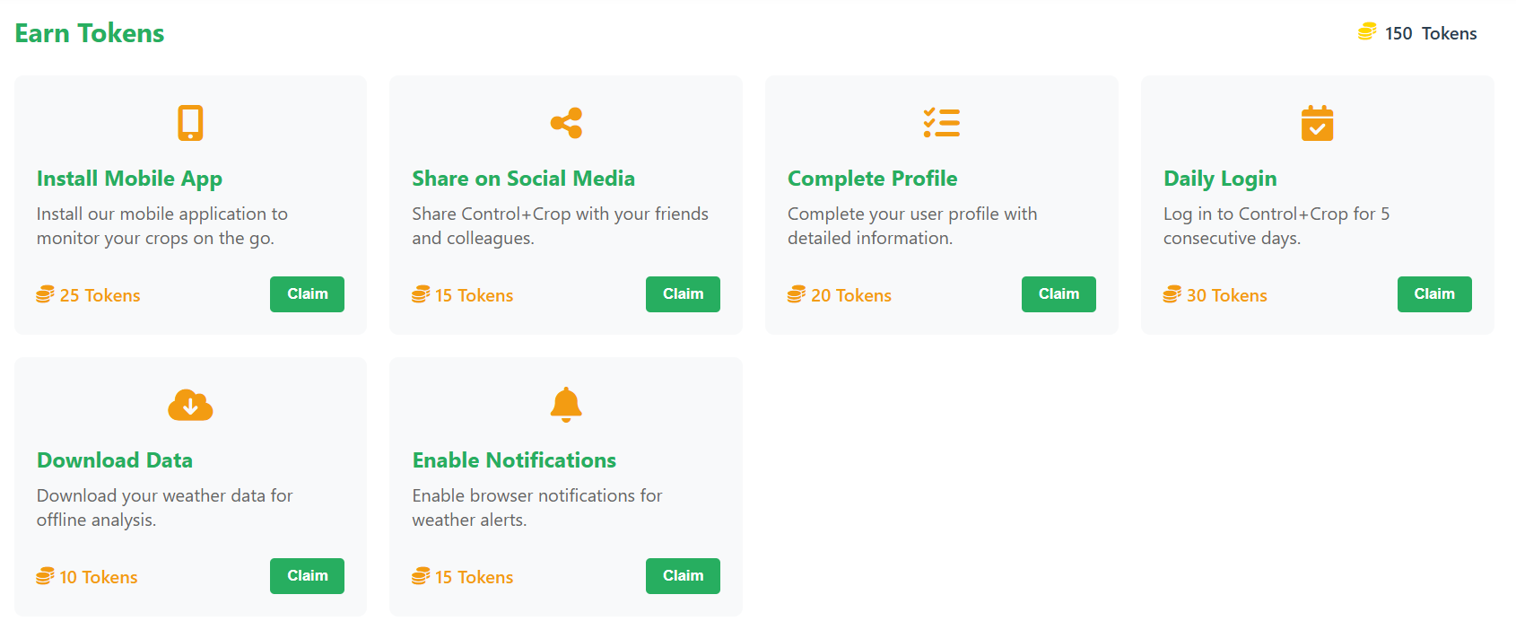
Demo / Screenshot
Satellite view
Earning tokens
11

Slide 12
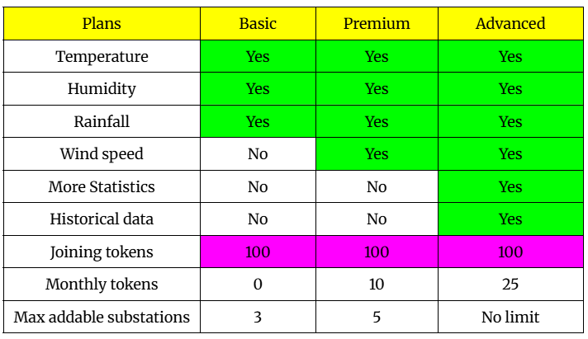
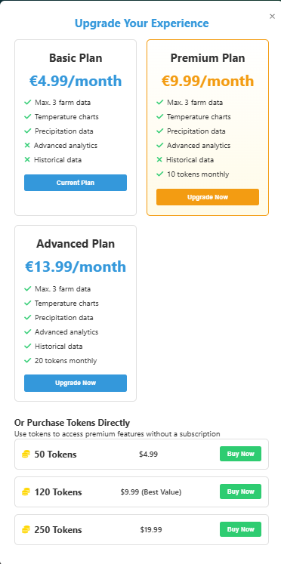
Demo / Screenshot
Subscription view
12

Slide 13
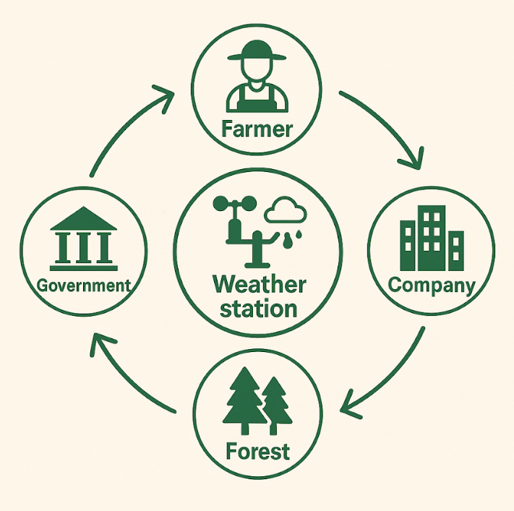
Thank You !

